Slide 1
Computer Principles for Programmers
File Systems and Visual Studio intro
Notes:
Welcome. Bienvenue. There are many other languages our colleagues speak; please say "welcome" in another language.
Embracing diversity is being willing to understand an issue from many points of view (the Apple formula for success). You encountered greetings you didn't understand –words are code for concepts. Given the context, you knew they meant something friendly. Greetings in some cultures can mean much more than a simple hello, e.g. "Shalom or Namaste or Salam". To really appreciate the person we refer to as the end user, we must also understand what they mean culturally, not just what they say in words.
Gender diversity is an issue in the IT industry. We need more women in this business for another point of view – a special welcome to the women in our class who are willing to put up all the guys. Since 2011, the percentage of women in ICT has ranged from 29.5% to a low of 26.4% with 26.7% in 2018. the ICT industry is facing a talent shortage. Canada will need to fill more than 200,000 technology-related positions by 2021. The growth in these jobs has outpaced the overall economy in the last two years by 4 to 1. Our supply of ICT graduates and workers will not meet this demand. (https://www.thestar.com/opinion/contributors/2018/07/01/its-time-to-close-the-gender-gap-in-tech.html)
Diversity is strength in IT – especially in software design and in the creation of the UX – User eXperience. Different points of view from various languages, cultures, genders, industries, disciplines are all valuable in designing and building good software. Facebook, Amazon, Apple, Netflix, Google (FAANG) would not be as successful, without multiple POV. Apple used to hire liberal arts majors. Steve Jobs: "technology alone is not enough—it’s technology married with liberal arts, married with the humanities, that yields us the results".
Students are not only here to learn from professors and course materials, students are also here to learn from each other – something you cannot do on YouTube. People come to college to improve their social skills for the business world, learn how to interact and work with others, how to compromise, how to deal with rejection and failure, and to learn what it is you don’t know. These are all things you cannot do on YouTube.
Programming isn't about coding; it is about solving problems. When problems are reduced to abstractions, the meaning of the application you coded can be lost. Think of a manufacturing robot – it has no idea of the importance of its work or how someone will appreciate the accuracy of its creation. The physical work of crafting a real object in a workshop is abstracted to a manual procedure which is abstracted to an algorithm which is abstracted to source code which is compiled for a computer to run a robot that reproduces that object. We must understand the original work that our source code represents—crafting that real object—in order to create a good UX – User Experience. Otherwise, our systems will solve users' problems only with luck. And being lucky is no way to be a professional.
[1] https://www.newyorker.com/news/news-desk/steve-jobs-technology-alone-is-not-enough
https://www.npr.org/2011/10/06/141115121/steve-jobs-computer-science-is-a-liberal-art

Slide 2
Agenda
Storing and Organising Data
If you had it all, where would you put it?
File Systems
Software development
Visual Studio IDE (Community Edition) demo
industry uses Enterprise Edition
Hello, World! program
Notes:
https://visualstudio.microsoft.com/vs/compare/
industry uses Enterprise Edition for large scale development projects.
Professional is identical to Community but used by small to mid-size organizations with 5 or more users/devices.
Enterprise organizations are defined as >250 PCs or > $1 Million US Dollars in annual revenue which is much closer to an org with 5 or more users/devices than 250.

Slide 3
Agenda
Activity (assignment):
Visual Studio IDE programming demo in C
File naming and file extensions
Working with local, external, and cloud drives for common file and folder operations

Slide 4
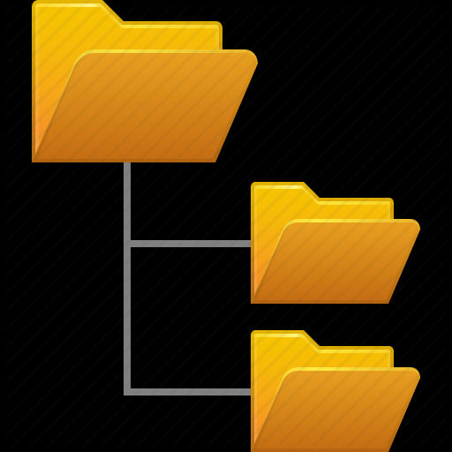
If you had it all, where would you put it?
Storage devices. Drive / root, Folder / Directory, File
Notes:
This is the start of the agenda question, If you had it all, where would you put it?
You can save things on your smartphone, tablet, or PC without caring where it is actually stored. It’s in there somewhere and the operating system (OS) can easily find it for you if you ask. It is similar to having all your clothing in one great big pile, probably two piles: one clean and one dirty. It can work if you live alone but the two pile method gets awkward when living with other people.
On a server, software cannot just ask the OS to find something and hope it finds what is needed. All resources on a server are explicitly organized, like a dresser with drawers for socks, underwear, t-shirts -- shelves for sweaters -- closets with shirts, suits, and dresses on hangers – a front hall closet with outerwear for the current season. Server resources are usually stored in an organized, hierarchical fashion…because a lot of people live in the same server.

Slide 5
Computer Storage
Volatile memory: needs constant power to retain data
RAM for primary storage. Fast – supports x-P-U __ Processing Units
Non-volatile memory: stores data persistently without power
Many types of secondary or mass storage. Slow – transfer to RAM
CPU
fast
RAM
slow
File: CourseSections
FPU
CPR101 SAA Mon 1-3
R e c o r d s
Course | Sec-tion | DoW | Period
APS145 | SAA | TUE | 3-4
CPR101 | SAA | MON | 1-3
IPC144 | SAA | TUE | 6-7
IPC144 | SBB | THU | 7-8
ULI101 | SAA | MON | 5-6
ULI101 | SBB | WED | 2-3
GPU
Notes:
In general, you probably know this already. However, the terms volatile, non-volatile, primary, secondary, and persistently should be clear in a programmer's mind.
RAM – Random Access Memory
CPU: central processing unit, or processor. Runs your computer. general workhorse. Capable of many different operations and memory transfers. Includes ALU: Arithmetic Logical Unit (integer calcs)
FPU: Floating Point Unit -- coprocessor for decimal / fractional calcs
GPU: graphics processing unit, or graphics card. Runs your graphics: video rendering, image rotation, shadowing, compression, … GPU’s are tuned for massively parallel calculations for use in video and image processing. Machine learning and crypto enthusiasts used the GPU parallel math capabilities to speed up their algorithms – faster on a GPU than on a CPU
TPU: tensor coprocessing unit. Runs the ASIC for neural network machine learning. accelerate neural computations (matrix-matrix and vector-matrix), cheaper and faster than GPU for Machine Learning -- deep learning (TensorFlow) and neural networks
ASIC: application specific integrated circuit. A customised circuit for a very specific use (rather than general purpose) such as Artificial Intelligence functions.
https://www.quora.com/How-can-CPU-FPU-and-GPU-be-explained-compared-and-contrasted https://www.quora.com/How-different-is-a-TPU-from-GPU
ROM – Read Only Memory
Persistently = permanently.
A file or set of data may be quite large and will not always fit into RAM. The CPU works only on portions of a file at a time, i.e. data elements (size & type, e.g. char or int) are used in RAM which come from fields in a record; a file contains many records which have similar information. E.g. a file of Seneca courses contains a record for each class; each record contains fields for course code, section code, room number, professor, day-of-week & from/to times, … A file is a grouping of related records.
https://en.wikipedia.org/wiki/Volatile_memory
https://en.wikipedia.org/wiki/Non-volatile_memory
Relative performance from https://www.enterprisestorageforum.com/storage-hardware/ssd-vs-hdd-speed.html
If HDD is 10ms, SSD would be 2.25ms, DRAM would be 0.00001ms or 10ns to 0.0001ms or 100ns, CPU cache would be 0.00001ms or 1ns to 0.00001ms or 10ns, CPU register would be 0.000001ms or 0.11ns. Overall, DRAM is ~100,000 to 1M times faster than HDD. CPU cache is an order of magnitude faster than DRAM, and CPU registers are an order of magnitude faster than CPU cache.

Slide 6
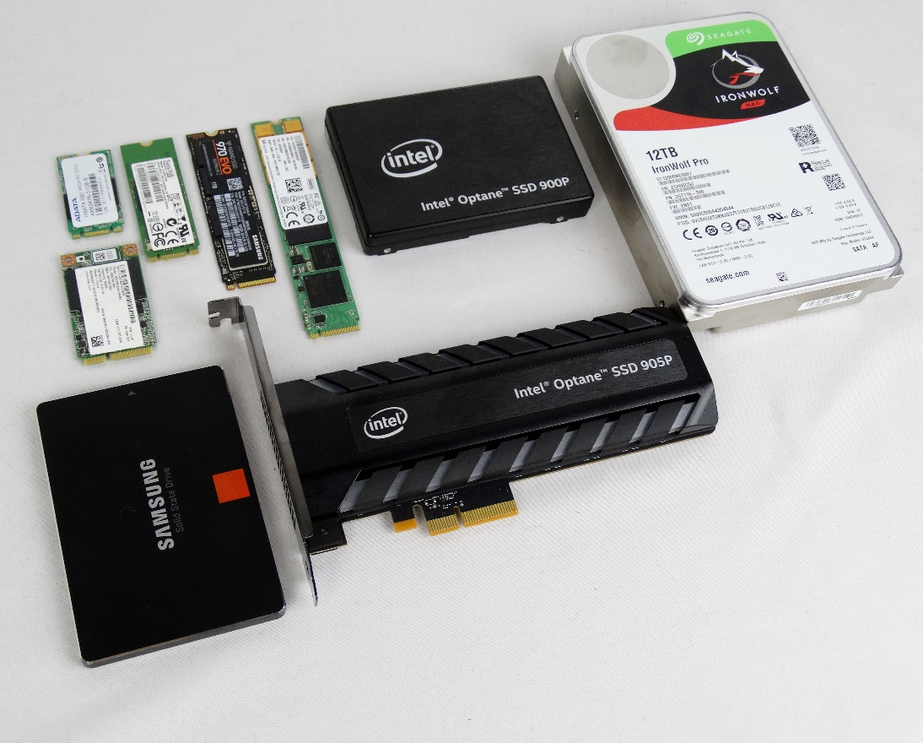
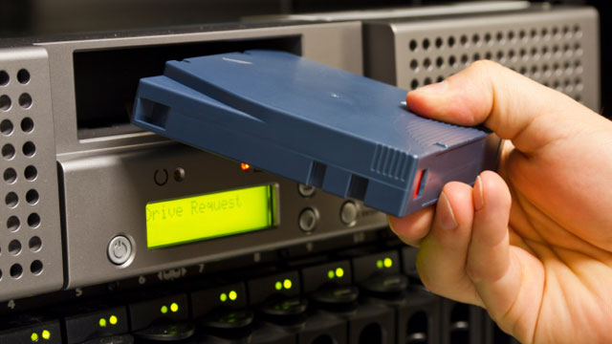
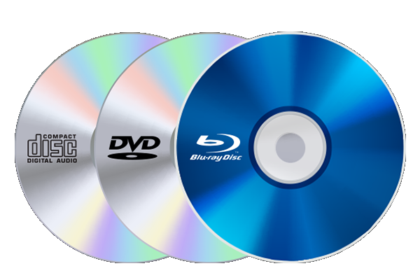

Persistent secondary storage devices
SSD
LTO
HDD
Linear Tape Open 18TB
Optical
CD DVD BD 100GB
USB personal use only
Notes:
For PCs and small servers: HDDs and SSDs can be mounted internally for high performance or via USB flash/portable/external for simple backups.
SSDs and HDDs are used in all sizes of systems. High capacity Blu Ray (BD) discs and LTO are used in enterprise backup systems.
The term "enterprise" when used in the ICT context means large organizations and/or large-scale systems.
See https://en.wikipedia.org/wiki/Enterprise_software for a general sense of the term's use.
USB attached devices are not used in enterprise data centers but are very handy for casual personal and small server use.
USB drives have low performance but high flexibility. Flash / pen / thumb drives are small cost & small capacity, low performance but highly portable, robust, and convenient. But are high cost per GB.
"portable" drives powered by the USB connection have larger capacity than flash drives but smaller capacity than externals.
"external" drives are larger capacity units needing their own power supply because they usually run HDDs within the enclosure.
https://en.wikipedia.org/wiki/USB_flash_drive
https://www.premiumusb.com/blog/whats-in-a-name-usb-flash-drive-synonyms
https://www.premiumusb.com/blog/how-long-can-usb-drives-last
http://searchstorage.techtarget.com/definition/USB-drive
https://www.makeuseof.com/tag/hard-drives-ssds-flash-drives-how-long-will-your-storage-media-last/
Usually disk refers to magnetic storage, disc refers to optical storage.
Consumer discs used as distribution media are "stamped", i.e. replicated, in mass quantities. Industry use of discs are individually burned.
CD – Compact Disc, originally developed for music distribution, 700MB
DVD – Digital Versatile Disc, used for video distribution replacing VHS tape media, thus the Digital Video Disc confusion.
BD – Blu-ray Disc. 25GB blank BD-R discs are affordable but have insufficient capacity for use "at scale" in large enterprises. 100GB BD-Rs used in industry backup/storage/archive systems.
For distribution purposes: You can no longer assume that everyone has a general purpose optical disc reader or, if they do, that it can read BD discs.

Slide 7
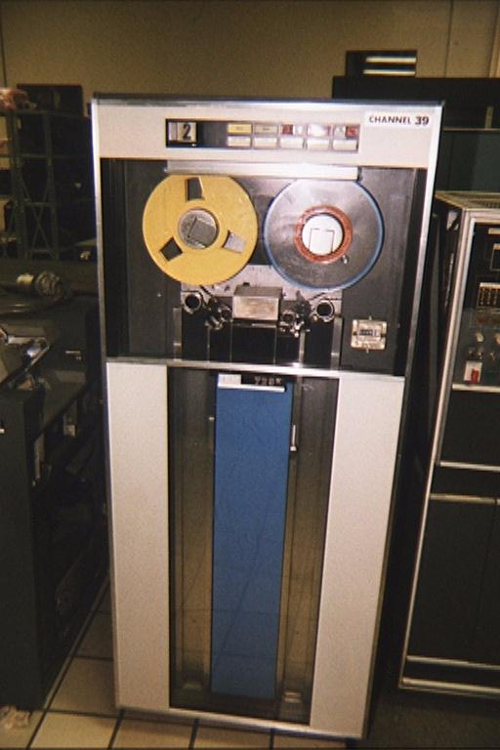
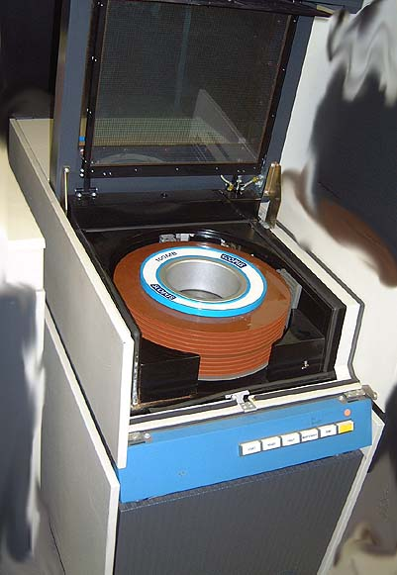
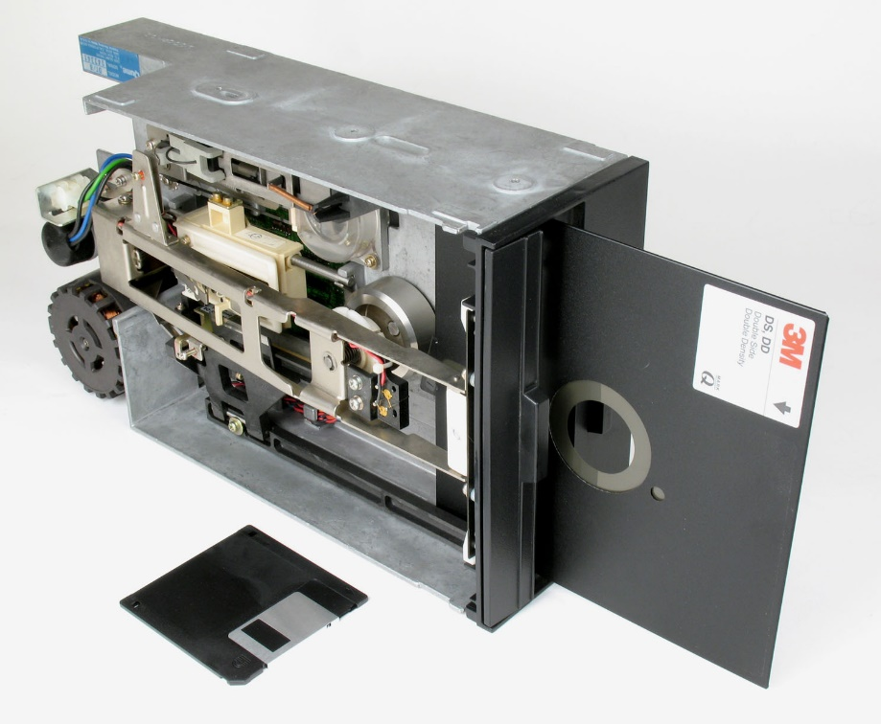
Persistent storage devices historically
Storage media were mounted on "drives" used by a "machine"
Tape Drive
Disk Pack Drive
Diskette Drive
Notes:
HDDs are "hard" versus Floppy Disk Drives used in the 1970s, 80s, (and 90s). The colloquial term floppy distinguished those disks from other disk systems with drives that, since 1956, had been only hard. The original "floppy" term was "diskette" – a little disk – but that 1971 term invented by IBC never got outside the computer room. The IBM PC, introduced in 1981, used FDDs like other microcomputers of the time. HDDs became affordable for personal computers in the mid to late 1980s. By that time, people were used to calling disks "floppys" because of PCs so the term hard disk drive ( C: ) came into use to distinguish them from floppy disk drives ( A: & B: ).
A young child comes to Dad holding a 3.5" 1.44MB floppy disk. “Daddy, Daddy, look! Somebody 3D-printed the save icon.”
https://english.stackexchange.com/questions/335105/etymology-of-the-use-of-drive-to-refer-to-a-digital-storage-medium

Slide 8
OS mounts a storage device to a Drive
Drive: storage device recognized by Operating System (OS)
OS mounts drives: recognizes hardware & assigns unique identifier C: or D: or E: ... in Windows (mounting is automagic) # mount /dev/sdc1 /media/usb-drive/ in Linux/Unix -hardware- ---- identifier ----
Mounting is the process of making the file system on a storage device accessible to the OS and your applications / software.
e.g. plug in a USB drive
Notes:
Automagic = as programmers, we know hardware and operating systems do things for us but we don't want to know how. Therefore, automagic.
Windows "mounts" a new storage device such as a USB device as a drive and does this automatically. DOS and Windows were designed for end users, Unix & Linux were designed for ICT geeks like you see around you in this room.
https://en.wikipedia.org/wiki/Mount_(computing)
https://www.ibm.com/developerworks/library/l-lpic1-104-3/index.html

Slide 9
Persistent storage – DAS "D-A-S"
Direct Attached Storage
within same server case or frame, direct connect to system motherboard
SSD – Solid State Drive
High performance, 10% of enterprise/cloud
High Total Cost of Ownership (TCO)
HDD – Hard Disk Drive
Good performance, 90% of enterprise/cloud
Low TCO
Scalability
constrained by drive capacity and
physical space within case or rack
Total Cost of Ownership (TCO)
1 × 22TB HDD is 1/6 TCO of 5.7 × 3.84TB SDD
Notes:
SSDs are currently 6 – 10 times the capital cost of HDDs per GB. SSDs usually last longer with twice the read/write life cycle of HDDs. https://www.tomshardware.com/features/ssd-vs-hdd-hard-drive-difference Operating expense is the electricity to run the device and the climate control system to manage the heat created. You pay twice for the energy to run computer systems.
Overall HDDs in active use consume at least twice the power used by SSDs to perform the same work. HDDs will also produce more heat which means even more power to run cooling fans and the computer room's climate control.
DAS Direct attach = storage devices installed within the computer on a data bus connected to a motherboard or disk controller, also known as 'internal' drives. Mostly used in PCs and smaller servers –limited by physical drive bay space in standalone systems.
https://en.wikipedia.org/wiki/Direct-attached_storage
https://www.cnet.com/how-to/digital-storage-basics-part-1-internal-storage-vs-memory/
https://www.backblaze.com/blog/how-reliable-are-ssds/
Why HDDs Dominate Hyperscale Cloud Architecture | Seagate Canada https://www.seagate.com/ca/en/blog/why-hdds-dominate-hyperscale-cloud-architecture/
Seagate's data comes from IDC; Seagate sells both HDD and SDD of all capacities and durability/reliability from consumer to enterprise/cloud level. i.e. they are not pitching a self-interested solution. They sell what the market demands.
HDDs currently dominate the cloud exabyte market—offering the lowest cost per terabyte based on TCO factors including price, cost, capacity, power, performance, reliability, and data retention.
SSDs provide an appropriate value proposition for performance-sensitive, highly transactional workloads closer to compute nodes i.e. servers. But TCO for SDD is 6 X HDD
HDDs represent the predominant storage for cloud data centers because they provide the best TCO for the vast majority of cloud workloads. More than 90% of exabytes in cloud data centers are stored on HDDs, and the remaining 10% are stored on SSDs according to market intelligence firm IDC. Industry analyst TRENDFOCUS stated that more than 1ZB of HDD storage capacity shipped in ~2021. 50 million 20-terabyte hard drives are needed to store one zettabyte of data. By 2025, 12.6ZB of installed storage capacity is projected, evenly split between business data centres and cloud service providers. Almost half of that capacity will be driven by data analytics, artificial intelligence, deep learning, and an increasing number of IoT devices capturing, creating, and exchanging data with other edge devices [IoT, smartphones, tablets] and the cloud.
Storage density of HDD continue to increase with same or increasing IOPS performance (Input/output Operations per Second) and same or decreasing power consumption as the lower-capacity drives of previous generations. increased HDD capacity is expected to offset any decline in SSD costs through to 2030.

Slide 10
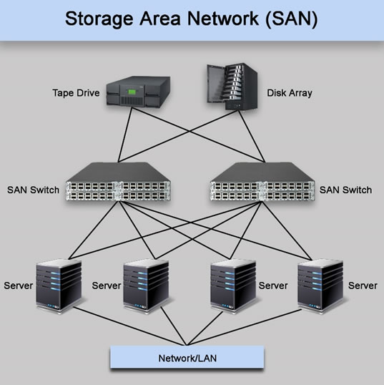
Persistent storage – SAN "SAN"
Storage Area Network
virtual drives. scalable. flexible.
servers see it as if it were DAS
similar function to DAS but unconstrained by drive capacity.
is effectively "attached"
provides storage for rack / blade diskless servers
Fibre Channel connect for high-performance.
Notes:
SAN Storage Area Network = block-level storage devices accessed through a dedicated high-speed connection with specialized protocol optimized for data transfer over a network, (independent of local area network traffic and generic network protocols). Functionally, it is similar to DAS (not NAS); it provides what appears to be a DAS drive to an attached server. https://en.wikipedia.org/wiki/Storage_area_network
Highly scalable meaning the system can grow to meeting increasing demands: add more storage to support more servers, higher/faster transaction loads, more raw capacity. https://en.wikipedia.org/wiki/Scalability

Slide 11

Persistent storage – Cloud
High Tier Cloud – needs high bandwidth, low latency, private network to cloud storage provider
is effectively "attached"
e.g. AWS S3 (Simple Storage Solutions), Google Cloud, MS-Azure
zero cap-ex but high op-ex
flexible, scales up | down easily
Not run over public Internet
Not OneDrive, Google Drive, Dropbox, iCloud, … used via the Internet
Notes:
High Tier Cloud needs high bandwidth + low latency private network connection to cloud provider.
e.g. "Amazon S3 now provides increased performance to support at least 3,500 requests per second to add data and 5,500 requests per second to retrieve data" – this does not happen through your regular ISP connection over the public switched Internet.
Consumer services such as OneDrive, Google Drive, Dropbox, iCloud, are file storage. They are not high-performance file serving or database engines.
TCO = cap-ex plus op-ex (capital expenditure to acquire, operations expenditure to run)
On-Premises Object Storage vs. Public Cloud for Enterprise Data Storage TCO is higher / lower for one versus the other depending on who you ask.
cloud has lower TCO than on-prem per https://www.globalrelay.com/wp-content/uploads/2021/09/GlobalRelay-EV-Cloud-TCO-Whitepaper.pdf
on-prem has lower TCO than cloud per https://www.fintechfutures.com/files/2020/10/Cloudian_Insiders_Guide_to_Secure_and_Cost_Effective_Storage_for_Financial_Services-1.pdf
https://cloud.google.com/network-tiers/
https://www.netapp.com/cloud-services/cloud-tiering/
Image from http://www.novacom.gr/portfolio_page/cloudcomputing/

Slide 12
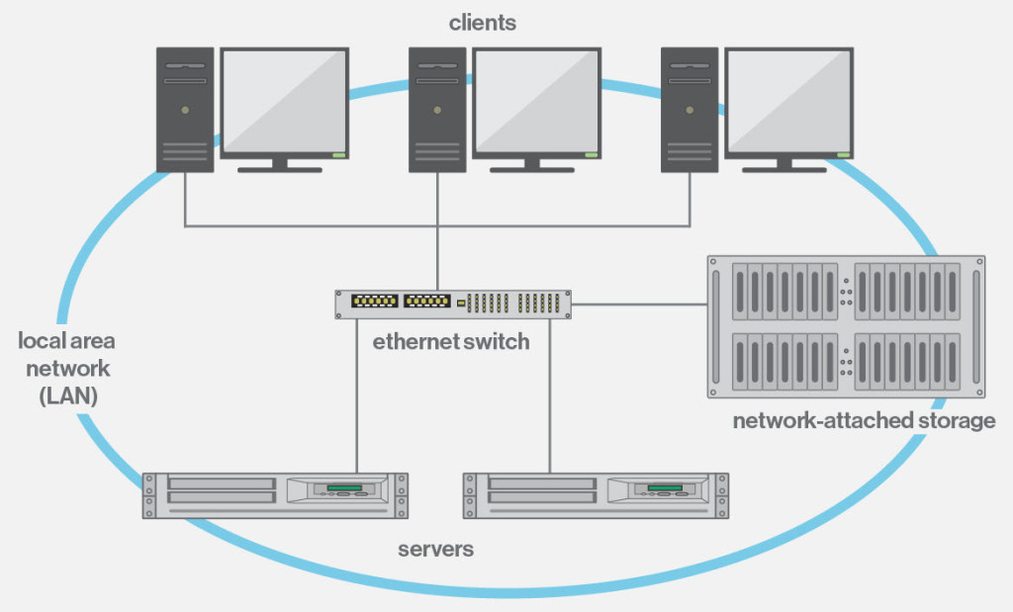
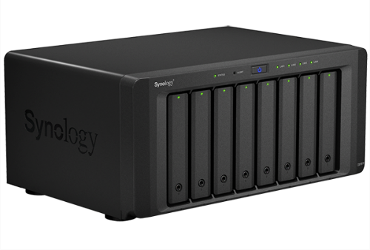
Persistent storage – NAS "N-A-S"
Network Attached Storage
file-level serving to any OS
good for backup and file storage
not for databases
Notes:
For purposes of disambiguation, “Attached” is used here to convey the meaning of “online” in this context of IT storage.
Since the Internet became ubiquitous, “online” has been synonymous with a user being on a network. Online means more than that.
For people with grey hair, “online” has been used since the early days of computing to indicate devices directly/closely attached to the main computing system.
For people with no hair, "online" was commonly used in the railroad and telegraph industries during the 19th century.
The meaning of “online” is somewhat tied to the century you grew up in. Us older guys are still getting used to a new century and the new millennium.
See https://en.wikipedia.org/wiki/Online_and_offline
OLTP ==> https://en.wikipedia.org/wiki/Online_transaction_processing
Storage types are listed on the slide from highest to lowest performance. WHY are each type high/low cap-ex & high/low op-ex ?
Capital vs operating expense: capital is acquisition cost – purchasing a device, SSDs are currently 6 – 10 times the capital cost of HDDs per GB. Operating cost is the electricity to run the device which creates waste heat and the climate control system to get rid of the excess heat. You pay twice for the energy to run computer systems.
DAS Direct attach = storage devices installed within the computer on a data bus connected to a motherboard or disk controller, also known as 'internal' drives. Mostly used in PCs and smaller servers –limited by physical drive bay space in standalone systems.
https://en.wikipedia.org/wiki/Direct-attached_storage
https://www.cnet.com/how-to/digital-storage-basics-part-1-internal-storage-vs-memory/
SAN Storage Area Network = block-level storage devices accessed through a dedicated high-speed connection with specialized protocol optimized for data transfer over a network, (independent of local area network traffic and generic network protocols). Functionally, it is similar to DAS (not NAS); it provides what appears to be a DAS drive to an attached server. https://en.wikipedia.org/wiki/Storage_area_network
Highly scalable meaning the system can grow to meeting increasing demands: add more storage to support more servers, higher/faster transaction loads, more raw capacity. https://en.wikipedia.org/wiki/Scalability
High Tier Cloud needs high bandwidth + low latency private network connection to cloud provider.
e.g. "Amazon S3 now provides increased performance to support at least 3,500 requests per second to add data and 5,500 requests per second to retrieve data" – this does not happen through your regular ISP connection.
NAS Network attach = storage devices accessible through the local area network. Range from industrial/enterprise size systems down to a Western Digital "My Cloud" device plugged into your home router. NAS is a file-level computer data storage server on a LAN providing data access to clients on multiple Operating Systems using various file sharing protocols including NFS/TCP (Network File System over TCP (Transmission Control Protocol). NAS file systems are independent of the platform that originally sent or is requesting the data. E.g. Apple, Windows, Linux, IBM operating systems all using different file systems, can send files to an NAS which can send a file to a different (heterogeneous) system – no more platform incompatibilities at the price of performance (NAS is a general-purpose file server as opposed to single purpose devices like SAN, DAS) and possible network traffic congestion/contention. https://en.wikipedia.org/wiki/Network-attached_storage https://en.wikipedia.org/wiki/Network_File_System https://en.wikipedia.org/wiki/Heterogeneous_computing
https://www.snia.org/sites/default/education/tutorials/2008/fall/applications/StephenDaniel_Running_Database_Application_NAS.pdf
In large data center, racks of diskless servers are connected to NAS and SAN systems.
https://en.wikipedia.org/wiki/Cloud_storage
https://aws.amazon.com/s3/storage-classes/
https://docs.aws.amazon.com/AmazonS3/latest/dev/optimizing-performance-guidelines.html
https://aws.amazon.com/about-aws/whats-new/2018/07/amazon-s3-announces-increased-request-rate-performance/
https://cloud.google.com/solutions/data-management
https://cloud.google.com/interconnect/docs/how-to/choose-type
https://cloud.google.com/hybrid-connectivity/
HDD Hard Disk Drive – 2.5-inch drives for laptops; 3.5-inch drives for desktops, servers, SAN, and NAS. A motor drives a disk with platters coated in magnetic material. https://en.wikipedia.org/wiki/Hard_disk_drive
High performance HDDs are seeing less use in data centers because i) they have both high cap-ex and higher op-ex than standard 5400 RPM drives and ii) their price/performance IOPS cost advantage relative to SSDs is falling.
https://en.wikipedia.org/wiki/Hard_disk_drive_performance_characteristics https://en.wikipedia.org/wiki/IOPS
http://royal.pingdom.com/2010/02/18/amazing-facts-and-figures-about-the-evolution-of-hard-disk-drives/
SSD Solid State Drive – 2.5",mSATA,M.2 form factors Integrated Circuits store data without mechanical moving parts. SSDs work by magic. As in "Any sufficiently advanced technology is indistinguishable from magic." Science fiction writer Arthur C. Clarke's third law appearing in "Hazards of Prophecy: The Failure of Imagination." (1973) https://en.wikipedia.org/wiki/Clarke%27s_three_laws
SSDs are more reliable than HDDs up to a point. SSDs will retain data for ~10 years but can wear out earlier after too many write cycles. SSDs may offer a lower TCO – Total Cost of Ownership for enterprises needing high performance access to data (Not necessarily high-performance writing of data.).
https://en.wikipedia.org/wiki/Solid-state_drive
Client vs Data Center/Enterprise SSDs https://youtu.be/xtYWw1mNn8s
https://hostadvice.com/hosting-guides/ssd-vs-hdd-hosting/
https://www.computerworld.com/article/3297957/an-ssd-designed-for-greater-toc.html (really just a paraphrased Samsung marketing pitch for their SSDs but some good info there)
https://www.storagereview.com/ssd_vs_hdd
https://www.google.com/search?q=ssd+vs+hdd+tco
https://www.enterprisestorageforum.com/storage-hardware/ssd-vs-hdd.html
https://www.pcmag.com/article/297758/ssd-vs-hdd-whats-the-difference
https://www.backblaze.com/blog/how-reliable-are-ssds/

Slide 13
Persistent storage – Attached
High-performance & availability
from fastest to slowest for high transaction loads (OLTP) & databases
Direct Attached Storage – within same case or rack, direct connection to system
SSD – Solid State Drive. High TCO = high capital expense & low operating expense
HDD – Hard Disk Drive. Lower TCO = low cap-ex & higher op-ex.
Limited scalability: constrained by drive size; physical space within case or frame
SAN – Storage Area Network – block-level data storage, Fibre Channel connect
virtual drives. scalable. functionally similar to DAS but independent of drive capacity.
provides storage for rack / blade diskless servers, uses special network-like connection.
High Tier Cloud – server needs sophisticated private network connection to cloud.
Not connected over public Internet. Not OneDrive, Google Drive, Dropbox, iCloud.
AWS S3, Google Cloud, MS-Azure – no cap-ex, very high op-ex. Scales quickly.
NAS – Network Attached Storage, file-level serving to any OS
Performance issues for database / OLTP hosting. good for backup and file storage.
Notes:
Slide is DETAILS FOR QUIZ
For purposes of disambiguation, “Attached” is used here to convey the meaning of “online” in this context of IT storage.
Since the Internet became ubiquitous, “online” has been synonymous with a user being on a network. Online means more than that.
For people with grey hair, “online” has been used since the early days of computing to indicate devices directly/closely attached to the main computing system.
For people with no hair, "online" was commonly used in the railroad and telegraph industries during the 19th century.
The meaning of “online” is somewhat tied to the century you grew up in. Us older guys are still getting used to a new century and the new millennium.
See https://en.wikipedia.org/wiki/Online_and_offline
OLTP ==> https://en.wikipedia.org/wiki/Online_transaction_processing
Storage types are listed on the slide from highest to lowest performance. WHY are each type high/low cap-ex & high/low op-ex ?
Capital vs operating expense: capital is acquisition cost – purchasing a device, SSDs are currently 6 – 10 times the capital cost of HDDs per GB. Operating cost is the electricity to run the device which creates waste heat and the climate control system to get rid of the excess heat. You pay twice for the energy to run computer systems.
DAS Direct attach = storage devices installed within the computer on a data bus connected to a motherboard or disk controller, also known as 'internal' drives. Mostly used in PCs and smaller servers –limited by physical drive bay space in standalone systems.
https://en.wikipedia.org/wiki/Direct-attached_storage
https://www.cnet.com/how-to/digital-storage-basics-part-1-internal-storage-vs-memory/
SAN Storage Area Network = block-level storage devices accessed through a dedicated high-speed connection with specialized protocol optimized for data transfer over a network, (independent of local area network traffic and generic network protocols). Functionally, it is similar to DAS (not NAS); it provides what appears to be a DAS drive to an attached server. https://en.wikipedia.org/wiki/Storage_area_network
Highly scalable meaning the system can grow to meeting increasing demands: add more storage to support more servers, higher/faster transaction loads, more raw capacity. https://en.wikipedia.org/wiki/Scalability
High Tier Cloud needs high bandwidth + low latency private network connection to cloud provider.
e.g. "Amazon S3 now provides increased performance to support at least 3,500 requests per second to add data and 5,500 requests per second to retrieve data" – this does not happen through your regular ISP connection.
NAS Network attach = storage devices accessible through the local area network. Range from industrial/enterprise size systems down to a Western Digital "My Cloud" device plugged into your home router. NAS is a file-level computer data storage server on a LAN providing data access to clients on multiple Operating Systems using various file sharing protocols including NFS/TCP (Network File System over TCP (Transmission Control Protocol). NAS file systems are independent of the platform that originally sent or is requesting the data. E.g. Apple, Windows, Linux, IBM operating systems all using different file systems, can send files to an NAS which can send a file to a different (heterogeneous) system – no more platform incompatibilities at the price of performance (NAS is a general-purpose file server as opposed to single purpose devices like SAN, DAS) and possible network traffic congestion/contention. https://en.wikipedia.org/wiki/Network-attached_storage https://en.wikipedia.org/wiki/Network_File_System https://en.wikipedia.org/wiki/Heterogeneous_computing
https://www.snia.org/sites/default/education/tutorials/2008/fall/applications/StephenDaniel_Running_Database_Application_NAS.pdf
In large data center, racks of diskless servers are connected to NAS and SAN systems.
https://en.wikipedia.org/wiki/Cloud_storage
https://aws.amazon.com/s3/storage-classes/
https://docs.aws.amazon.com/AmazonS3/latest/dev/optimizing-performance-guidelines.html
https://aws.amazon.com/about-aws/whats-new/2018/07/amazon-s3-announces-increased-request-rate-performance/
https://cloud.google.com/solutions/data-management
https://cloud.google.com/interconnect/docs/how-to/choose-type
https://cloud.google.com/hybrid-connectivity/
HDD Hard Disk Drive – 2.5-inch drives for laptops; 3.5-inch drives for desktops, servers, SAN, and NAS. A motor drives a disk with platters coated in magnetic material. https://en.wikipedia.org/wiki/Hard_disk_drive
High performance HDDs are seeing less use in data centers because i) they have both high cap-ex and higher op-ex than standard 5400 RPM drives and ii) their price/performance IOPS cost advantage relative to SSDs is falling.
https://en.wikipedia.org/wiki/Hard_disk_drive_performance_characteristics https://en.wikipedia.org/wiki/IOPS
http://royal.pingdom.com/2010/02/18/amazing-facts-and-figures-about-the-evolution-of-hard-disk-drives/
SSD Solid State Drive – 2.5",mSATA,M.2 form factors Integrated Circuits store data without mechanical moving parts. SSDs work by magic. As in "Any sufficiently advanced technology is indistinguishable from magic." Science fiction writer Arthur C. Clarke's third law appearing in "Hazards of Prophecy: The Failure of Imagination." (1973) https://en.wikipedia.org/wiki/Clarke%27s_three_laws
SSDs are more reliable than HDDs up to a point. SSDs will retain data for ~10 years but can wear out earlier after too many write cycles. SSDs may offer a lower TCO – Total Cost of Ownership for enterprises needing high performance access to data (Not necessarily high-performance writing of data.).
https://en.wikipedia.org/wiki/Solid-state_drive
Client vs Data Center/Enterprise SSDs https://youtu.be/xtYWw1mNn8s
https://hostadvice.com/hosting-guides/ssd-vs-hdd-hosting/
https://www.computerworld.com/article/3297957/an-ssd-designed-for-greater-toc.html (really just a paraphrased Samsung marketing pitch for their SSDs but some good info there)
https://www.storagereview.com/ssd_vs_hdd
https://www.google.com/search?q=ssd+vs+hdd+tco
https://www.enterprisestorageforum.com/storage-hardware/ssd-vs-hdd.html
https://www.pcmag.com/article/297758/ssd-vs-hdd-whats-the-difference
https://www.backblaze.com/blog/how-reliable-are-ssds/

Slide 14
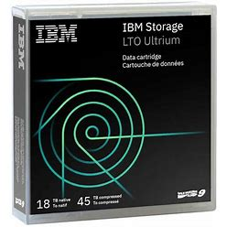
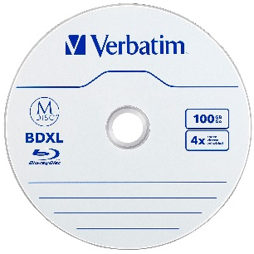
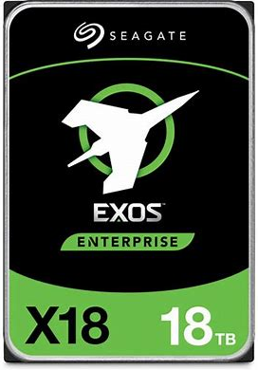
Persistent storage – Offline & Nearline
Backup & Archiving "cold storage"
Linear Tape-Open (LTO-9 18TB)
Optical Disc (Blu Ray 100GB)
HDD 18TB
low cap-ex & op-ex, slow / low performance
Offline (tape | optical), Nearline (tape | optical library, MAID)
Offline = manually retrieve tape/disc from physical storage and mount
Nearline = robotic mounting of tape/disc or Massive Array of Idle Drives
Cloud cold storage: AWS Glacier, GCS Coldline, BackBlaze B2
Notes:
BACKUP
LTO-9 18TB tape ~45TB highly compressed data (i.e. not photos, not video, not FLAC audio) cost USD$150
18TB HDD cost USD$300 but lower cap-ex & op-ex than 8TB drives because they occupy only one slot in a SAN
HDD more than 2X cost/TB of LTO-9 because tape costs very little to store on a shelf.
https://en.wikipedia.org/wiki/Linear_Tape-Open
Blu Ray 100GB discs ~$1 in quantity (in the same capital cost ballpark as LTO tape cartridges and similar operating expense)
MAID Massive Array of Idle Drives used in Cloud services for backup and storage of data which rarely changes.
LTO, optical, and cloud cold storage systems/services – each claim to be the cheapest compared to the other systems/services.
Facebook has been using robotic optical for cold storage for a few years.
http://www.digitalpreservation.gov/meetings/documents/storage14/Kestutis_Patiejunas_Facebook_FreezingExabytesOfDataFacebooksColdStorage.pdf
Cloud cold storage backup is very low op-ex but restoring from backup is high op-ex and slow! The less you pay to store, the higher the cost and/or longer it takes to restore.

Slide 15
What is a File? What is Data?
File: uniquely named space on a Drive. Files contain Data.
Data: a sequence of formatted symbols
Software: encoded machine instructions (data in .exe executable file) compiled from source code (data in a .c file)
Information: data interpreted by software that performs a task
MS Word file: data encodes words and images into an essay or book
Plain Text file: stream of ASCII characters.
<html> markup with a web site’s content (Ctrl-U in a browser to see it)
programming source file's formatted symbols: #include <stdio.h>
Code: human readable instructions for a compiler to generate an executable file.
Comments: explanations for humans to understand the code
Notes:
An operating system (OS) knows where a file is and provides read/write access to that file by application software. Application software expects the raw data in a file to be organized by a format (e.g. rows and columns, lines and characters with syntax and punctuation) in order to represent meaningful information.
Data must be formatted to be useful and meaningful.
What is in a programming language ‘source’ file?
Code: human readable instructions for a compiler to generate an executable file.
Comments: human readable explanations for other humans to understand the code. (most important part)
https://en.wikipedia.org/wiki/Computer_file
https://en.wikipedia.org/wiki/ASCII
https://en.wikipedia.org/wiki/Data_file
https://en.wikipedia.org/wiki/File_format
https://en.wikipedia.org/wiki/Namespace
https://en.wikipedia.org/wiki/Data_(computing)
https://en.wikipedia.org/wiki/Metadata
https://en.wikipedia.org/wiki/Plain_text
https://en.wikipedia.org/wiki/Formatted_text
https://en.wikipedia.org/wiki/Source_code
https://en.wikipedia.org/wiki/Syntax_(programming_languages)
https://en.wikipedia.org/wiki/Executable

Slide 16
Data format == meaning
Words sorted in alphabetic order: a her is man nothing without woman
With Sequence and Punctuation: A woman without her man is nothing.
With same Sequence but different Punctuation: A woman: without her, man is nothing.
Data must be formatted to be useful and meaningful.
so does source code!

Slide 17
How is a house and its things organized?
Main floor
Kitchen
Dining room
Living room
Second floor
Bedrooms 1,2,3
Basement
Garage
Rooms and furniture use cases…
to sit on
to place stuff on
to store stuff in
to sleep on
for working
for exercising
for relaxing
Notes:
Something to sit on:
How many different kinds?
Might every room have chairs or stools?
Are they the same kind of chairs in kitchen, dining room, living room, bedroom, study/office?
Lawn chairs: permanent on the patio, portable in the garage/basement
Something to place stuff on:
Breakfast table, dining table, coffee table, desk
Kitchen counter, work bench in garage/basement
Something to store small stuff in:
Kitchen cabinets, dresser drawers, shelving units to hide messy stuff or display nice stuff.
Something to sleep on:
Bed, hammock, couch where friends might surf or residents might do penance
Think of your PC as a house…

Slide 18
Directory Structures, Parent-Child Directories
hierarchical tree structure.
Courses is the parent of CPR101, IPC144, and ULI101 directories
CPR101 is a child of the Courses directory
Notes:
https://en.wikipedia.org/wiki/Directory_structure
e.g. Biological Taxonomy
Kingdom Phylum Class Order Family Genus Species
Animalia Chordata Mammalia Primata Hominidae Homo Sapiens

Slide 19
What is a Folder/Directory?
file system's hierarchically named cataloging structure
C:\Users\you\Documents\Seneca\CPR101 C:\Program Files\Microsoft Office\Office16
contains Files and/or other Folders / Directories.
Helps to organize files that share some commonality
Directories within directories are sub-directories or sub-folders in a hierarchical structure
Windows & Mac OS: directories are known as Folders
Linux/Unix: directories are still called directories
Notes:
"hierarchically named" means you can have more than one of the same file or folder names as long as they are in different folders/directories.
You could organize files simply by using really long filenames that completely described their category, purpose, content, and so on. But it is better using directories because humans can be quite good at organizing information hierarchically.
https://en.wikipedia.org/wiki/Directory_(computing)

Slide 20
Path and Filename structure
Windows C:\users\student\CP4P-week1.docx Linux /users/student/CP4P-week1.docx
drive root
folder directory
sub-folder sub-directory
filename FileName
extension (optional)
Full Path Name is the unique identifier of a file in a system:
[drive|root] / folder / sub-folder(s) / filename.ext
Windows: case-independent with \ backslash separators
Linux/Unix: case-dependent with / forward slash separators
Notes:
A reference to a location in a filesystem is called a path.
A path is the location of a file in a hierarchy of directories.
A full path name from drive|root through directories down to a filename.ext solves the problem of needing unique names for every file on the system:
Files can have the same name when they are in different directories.
A directory is a file system concept, a folder is a graphical user interface metaphor which usually represents a directory. The terms are often used interchangeably.
https://en.wikipedia.org/wiki/Directory_(computing)
https://en.wikipedia.org/wiki/Directory_structure
https://en.wikipedia.org/wiki/Path_(computing)
Unix and Unix-like operating systems use the Filesystem Hierarchy Standard as the common form for their directory structures. All files and directories appear under the root directory "/", even if they are stored on different physical devices.
https://www.howtogeek.com/181774/why-windows-uses-backslashes-and-everything-else-uses-forward-slashes/
DOS 2.0 & Windows uses \ character for C:\directory\*.* because / was already used as switch char for command options. E.g. > dir /s C:\directory
Unix was smart enough to use the "-" hyphen as the command line switch character so had no conflict with / as directory separator.
> ls –R \

Slide 21
File Extensions
A file extension is the code (1 – 5 characters) at the end of the filename, proceeded by a period "." that denotes the generic type of file
Windows associates a file's extension with the application that processes the file’s data
CP4P-week1.docx (MS-Word) sourcecode.c (C language source editor)
readme.txt (Notepad) notepad.exe (OS launches this app)
Double click a file to launch the application which opens that file
Files do not require an extension, although they usually have one
By default, Windows does not display file extensions in File Explorer but programmers should override this behaviour (View menu).
Notes:
https://en.wikipedia.org/wiki/Filename_extension
http://www.thewindowsclub.com/change-file-associations-windows

Slide 22
Common File Extensions
Extension | File Type
.doc, .docx | Microsoft Word
.txt | Plain Text
.jpg | JPEG Image
.xls, .xlsx | Microsoft Excel
.html, .htm | HTML file
.c | C Source Code
.cpp | C++ Source Code
.rtf | Rich Text Format
Extension | File Type
.zip | ZIP Compressed File
.exe .bin | Executable program
.js | JavaScript File
.php | PHP Source Code
.css | Cascading Style Sheet
.pdf | Portable Document Format
Notes:
We are used to the OS automatically launching the application that knows how to read a file's data and make it useful to us.
https://www.lifewire.com/list-of-executable-file-extensions-2626061
Unix & Linux use MIME types which are usually cross-referenced to .extensions e.g. from a Windows system, upload an "index.html" file to a Linux Web server or GitHub and it will automatically be processed as expected.
See Introduction to File MIME Types | Baeldung on Linux https://www.baeldung.com/linux/file-mime-types

Slide 23
Naming Conventions
Make directories and files to easy to work with, search for, and understand, especially when working on servers.
Directory / Folder Naming Guidelines:
hierarchical names of categories and sub-categories
File Naming Guidelines:
Clear, short identifier of content and version number
Correct file extension
Understandable a year from now at 3AM
Notes:
https://www.google.ca/search?q=organize+files+and+folders
https://zapier.com/blog/organize-files-folders/
http://www.asianefficiency.com/organization/organizing-files-folders-documents/
https://www.howtogeek.com/howto/15677/zen-and-the-art-of-file-and-folder-organization/

Slide 24
Common File/Folder Operations
Left click drag and drop to
same drive → Move (within same instance of a file system)
another drive → Copy (from one file system instance to another)
Right click drag and drop ⬅ ICT people always do this
have Move | Copy option (half the time you’ll want the other one)
Delete to Recycle Bin (keep R-U-sure? to avoid mistakes)
Enable Recycle Bin for Removable Drives
Rename many files: Windows PowerToys PowerRename
Notes:
Why keep R-U-sure? when deleting a file? Because programmers often have File Manager windows open along with code editors and Word/Excel/Outlook. Someday soon, you will be looking at the code editor window, press Delete, and later that night, wonder where an important file or folder has gone to.
(the File Manager window had the focus while you were looking and thinking about deleting an email, or editing something.)
The Recycle / Trash bin is not a reliable recovery strategy.
You can change the Windows File Explorer default from Move to Copy – highly recommended.
How to Set Default File Drag and Drop Behavior on Windows 10 (howtogeek.com) https://www.howtogeek.com/677102/how-to-set-default-file-drag-and-drop-behavior-on-windows-10/
https://winaero.com/set-the-default-drag-and-drop-action-in-windows-10-windows-8-and-windows-7
Winaero - At the edge of tweaking – extremely handy for programmer productivity. https://winaero.com/
Microsoft PowerToys | Microsoft Docs
https://docs.microsoft.com/en-us/windows/powertoys/
https://www.windowscentral.com/how-rename-multiple-files-bulk-windows-10

Slide 25
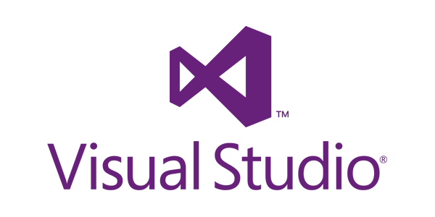
Visual Studio demo and activity

Slide 26
Notes
What follows will not be on the quiz but it is worth your attention. It is here to provide more background and depth to today's topics.

Slide 27
For later…
Reshma Saujani
TED Talk: teach bravery not perfection. ~5M views
Founder of Girls Who Code
Author of
Brave, Not Perfect (2019)
Girls Who Code (2017) NYT bestseller
Women Who Don't Wait in Line (2013)
Notes:
Highly recommended for both genders. Her TED talk is worth 12 minutes of your time. These slides will be available later today.
When women rise, we all rise | Microsoft In Culture https://www.microsoft.com/inculture/womenshistorymonth/

Slide 28
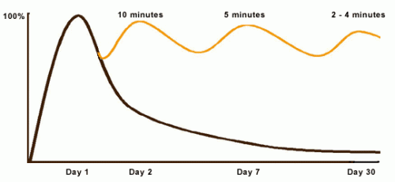
Curve of Forgetting, Sine Wave of Remembering
Review = Retention = Quiz marks
Review = Retention = Test marks
See U of Waterloo and Ebbinghaus
Notes:
Review these lecture notes tomorrow, then 6 days from now before you go to sleep. On the 7th day from now, you'll do fine on the quiz.
https://joshkaufman.net/3-simple-techniques-to-optimize-your-reading-comprehension-and-retention/
https://theconversation.com/whats-the-best-most-effective-way-to-take-notes-41961
https://www.apa.org/science/about/psa/2016/06/learning-memory
https://www.google.ca/search?q=Ebbinghaus+forgetting+curve
https://uwaterloo.ca/campus-wellness/curve-forgetting
On day 1, at the beginning of the lecture, you go in knowing little of what might be said ( 0% baseline). At the end of the lecture you know 100% of what you know, however well you know it (where the curve rises to its highest point).
By day 2, if you have done nothing with the information you learned in that lecture, didn't think about it again or read it again, you may have lost 50%-80% of what you learned.
By day 7, we remember even less, and by day 30, we retain about 2%-3% of the original hour. It's pretty much gone…you know this. Have you ever wondered when taking a quiz or writing an exam, "Where did this question come from?"
You can change the shape of the curve! Reprocessing the same chunk of information sends a big signal to your brain to hold onto that data. When the same thing is repeated, your brain says, "Oh - there it is again, I better keep that." When you are exposed to the same information repeatedly, it takes less and less time to "activate" the information in your long term memory and it becomes easier for you to retrieve the information when you need it.
Here's the process:
after a good night's sleep and within 24 hours of getting the information, spend 10 minutes reviewing and you will raise the remembering curve to almost 100% again. A week later (Day 7), it takes 5 minutes to "reactivate" the same material and raise the curve back up. By Day 30, your brain will need 2-4 minutes of review to not only remember what you knew on Day 1 but will likely understand more than you did then. During the test, you'll think, "Hey, I know where that question came from…"
Often students feel they can't possibly make time for a review session every day in their schedules – students have trouble keeping up as it is. However, this review is a pro-active investment of less than one-half hour of your time. If you don't review, you will need to spend 40-50 minutes re-learning each hour of material later. So, if you don't have time now, exactly when are you going to have that kind of time in the future when things get even busier?

Slide 29
Persistent storage device architectures
Direct Attach Storage – DAS
Internal and removable drives attached to a computer/server
Network Attach Storage – NAS
appears as file server with a file system native to the requesting OS
for data sharing among many users & systems on the same intranet
used for home office, Small to Medium sized Enterprises (SMEs)
Storage Area Network – SAN
appears as drive to an OS, similar to DAS but separates computing from storage
multiple computers use a single pool of storage
high performance, flexibility, and complexity for large Enterprises and cloud services
NAS and SAN can provide automatic backup and snapshotting, storage reliability and redundancy, and scalability.
Cloud Drives (iCloud, OneDrive, Dropbox, Google/Amazon Drive)
Internet + drivers can make remote storage look like DAS; for individual use
Cloud services can provide virtual NAS and SAN for enterprises
Notes:
Cloud Drives are mythical places where data is stored.
The Cloud? There's no such thing; it's your stuff on someone else's machine. OK, there's more to it than that and we'll get to it later in the course.
https://what-if.xkcd.com/31/
https://gizmodo.com/what-is-the-cloud-and-where-is-it-1682276210
https://www.pcmag.com/article2/0,2817,2372163,00.asp
https://www.cnet.com/how-to/onedrive-dropbox-google-drive-and-box-which-cloud-storage-service-is-right-for-you/
http://www.thewindowsclub.com/map-onedrive-network-drive-windows-10
https://www.techrepublic.com/article/is-the-cloud-really-just-someone-elses-computer/
http://www.zdnet.com/article/stop-saying-the-cloud-is-just-someone-elses-computer-because-its-not/
NAS and SAN
https://www.backblaze.com/blog/whats-the-diff-nas-vs-san/
https://www.infoworld.com/article/2871290/understanding-cloud-storage-models.html

Slide 30
What is a Character?
A character is usually considered to be anything you can type on a keyboard. Technically, a character is a byte with an ASCII value. "ASCII codes represent text in computers, telecommunications equipment, and other devices."
Each standard character requires one byte of storage in a file or in memory. (Double byte character sets exist for pictographic languages.)
Some examples: Aa Bb Cc … Zz, 0 – 9, !@#$%^&*()
Note that Tab [  ] Space [ ] and Enter/Return [  ] are also characters!
Notes:
https://en.wikipedia.org/wiki/ASCII
https://en.wikipedia.org/wiki/DBCS

Slide 31
What are Reserved Characters?
Operating Systems have reserved characters for filenames and command line inputs. Characters you might use in simple text, such as a question mark, have other meanings or functions when interacting with the OS.
Do not use these characters in file or directory names: / \ ? % * : | " ' < > [ ] { } ( )
The use of a space character in a filename is legal but not recommended. To separate words within a filename, use a – (dash) or _ (underscore) or CamelCase.
Notes:
https://en.wikipedia.org/wiki/Filename#Reserved_characters_and_words

Slide 32
More About Directory Structures
In Windows, the \ back-slash is a folder name separator.
In *nix, the / forward-slash is a directory name separator. *nix refers to both Linux and Unix.
./ and ../ have special meanings in folder & directory structures
./ refers to the current directory
../ refers to the parent directory
Notes:
https://www.howtogeek.com/181774/why-windows-uses-backslashes-and-everything-else-uses-forward-slashes/
DOS 2.0 & Windows uses \ character for C:\directory\*.* because / was already used as switch char for command optionss. E.g. > dir /w C:\directory\*.*
Unix used "-" hyphen as the switch character so had no conflict with / as directory separator.

Slide 33
Absolute and Relative Paths
We are in one location within a file system at a time, that is the current directory
By default, any operations executed by the OS will occur within the current directory.

Slide 34
Absolute and Relative Paths
The absolute path is consistent from the root.
week1_notes.docx is in the absolute path C:\Courses\CPR101\
The absolute path is independent of the current directory.

Slide 35
Absolute and Relative Paths (Cont’d)
The relative path depends on the current .\ and parent ..\ directories.
relative to .\IPC144 week1_notes.docx is in ..\CPR101\

Slide 36
Wildcards
In file operations, we may want to access or work with multiple, similarly named files, or with files where we do not know the full filename.
Use wildcards to help with this: ? matches any single character * matches zero or more characters
gloss* matches Glossary.txt, Glossary.doc, Glossy.doc
gloss*.doc matches Glossary.doc and Glossy.doc
gloss?.doc matches Glossy.doc but not Glossary.doc.
Notes:
https://technet.microsoft.com/en-us/library/bb490639.aspx
http://www.linfo.org/wildcard.html

Slide 37
Wildcards (Cont’d)
From .\CPR101\ which files are matched by
week*.docx
week2_screenshot?.jpg
week*.doc*
*.*

Slide 38
File Attributes in Windows
File Attributes (archive, hidden, read-only, system, compressed) tell the OS how to handle the file.
Attributes can be set on or off.
To check or set the attributes of a file or directory in File Explorer, right click the item and select Properties.
read-only on means the file cannot be changed
archive: OS sets this attribute on when a file is changed. Backup software must set this attribute off upon a successful backup.

